Slide 1
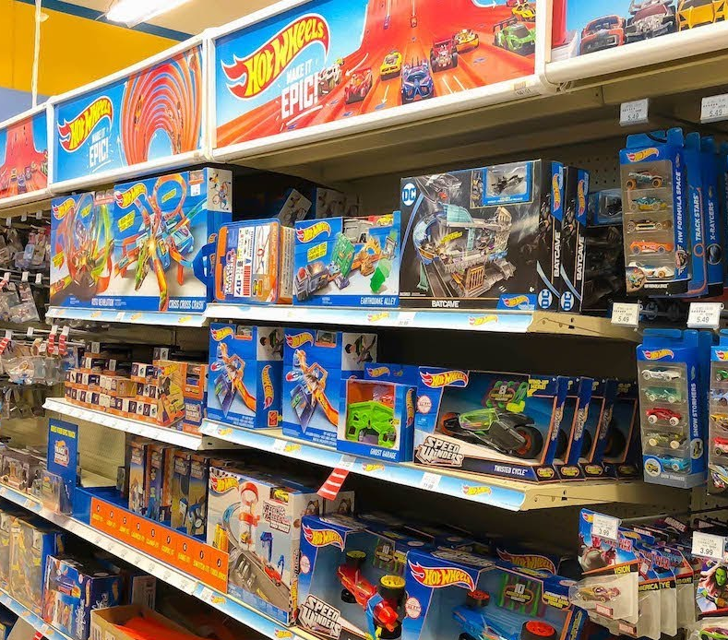
Collectable Toy Challenge
Leon Sandhu

Slide 2
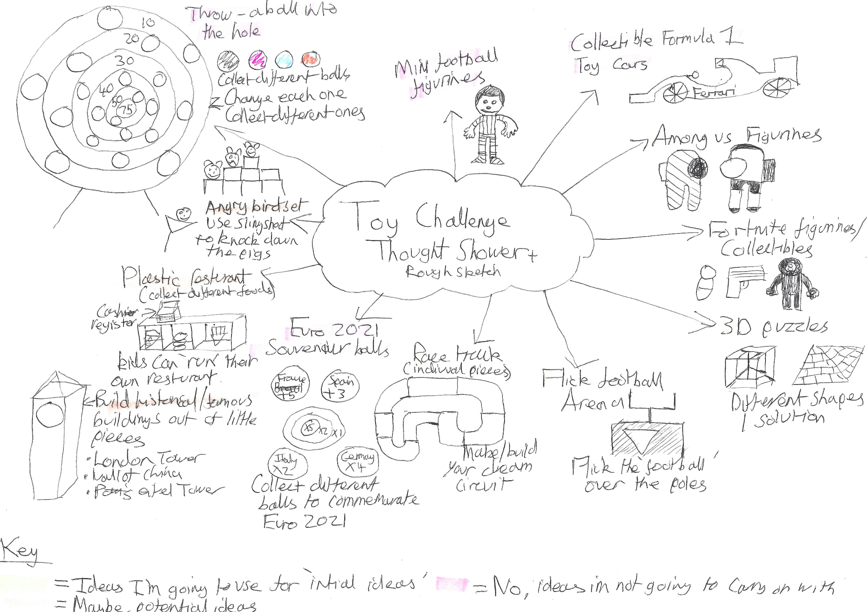
Thought shower
Aim: Brainstorm of ideas
Evaluation or next steps: I have chosen 5 ideas from this thought shower for my initial ideas.

Slide 3
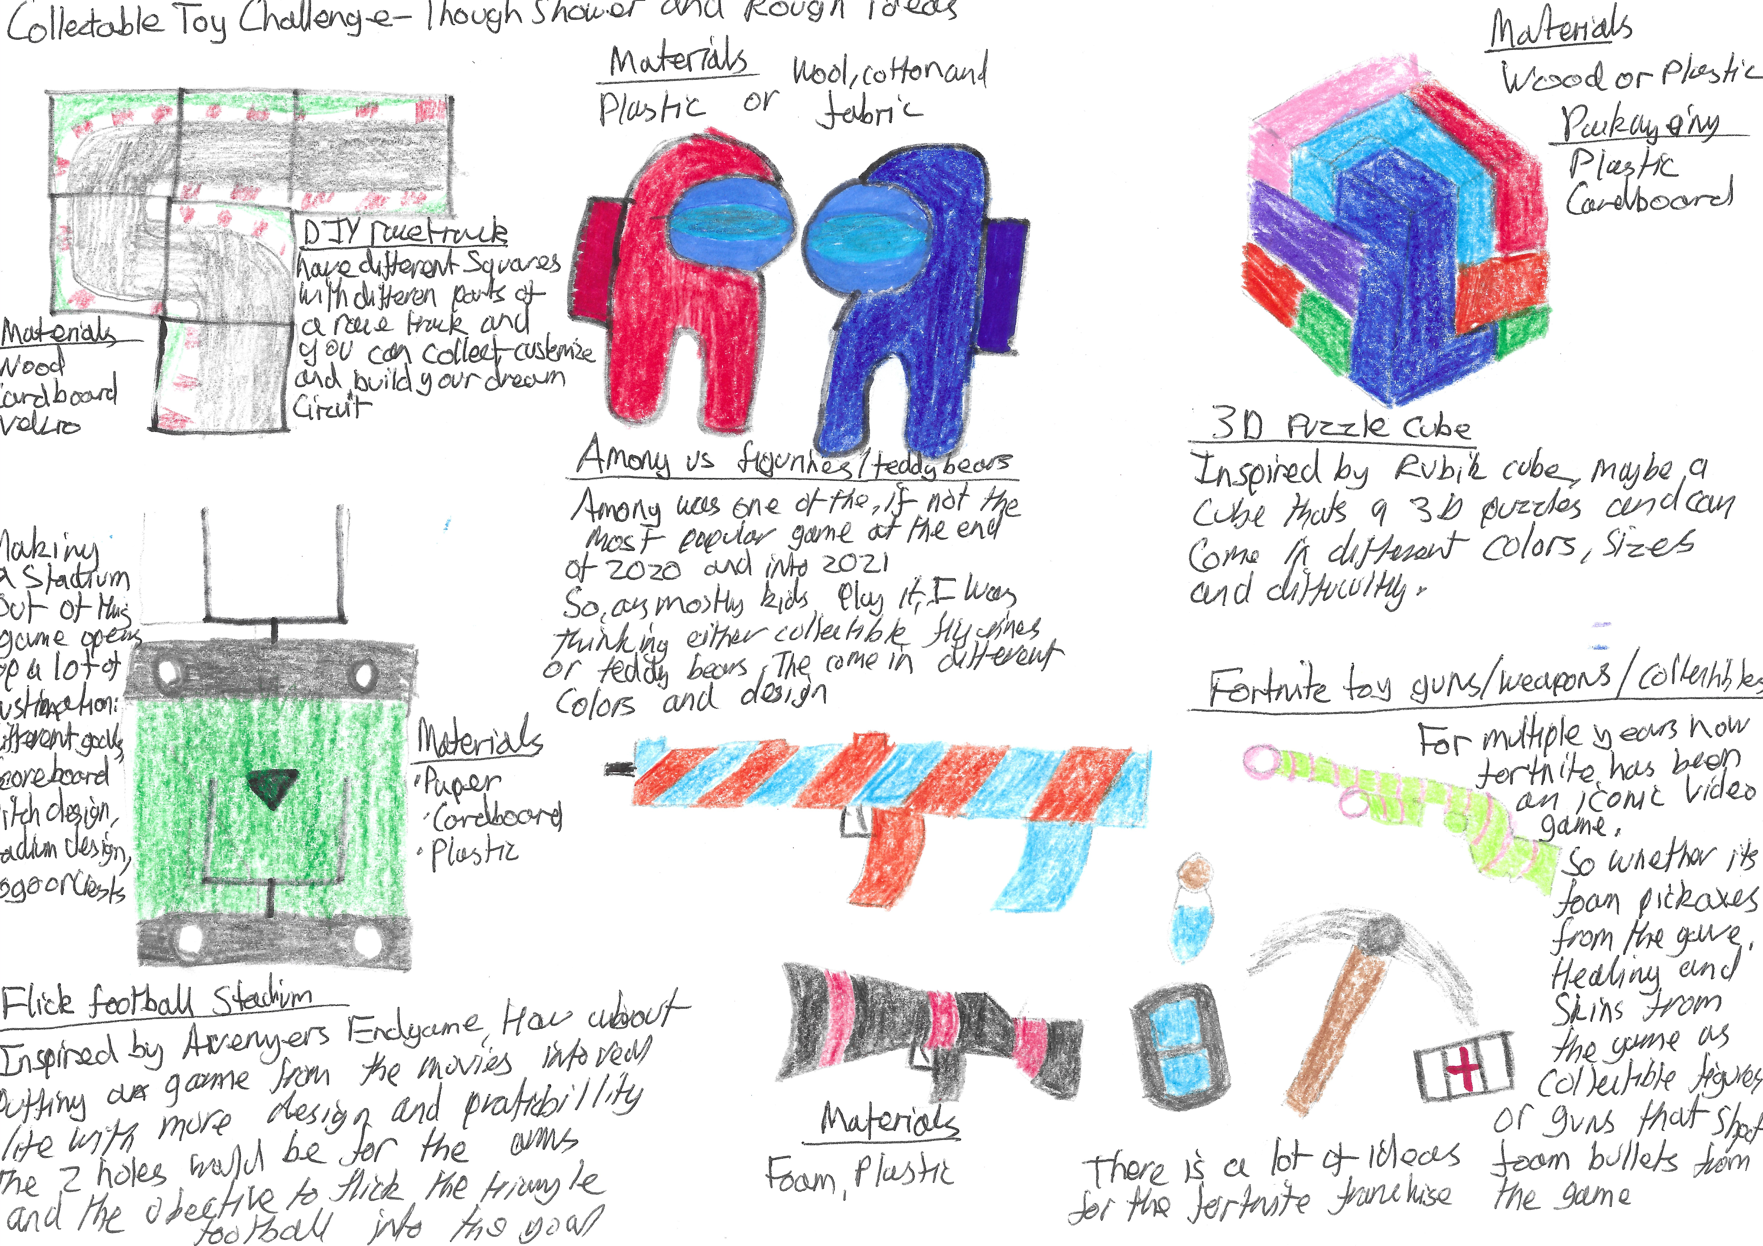
Initial ideas
Aim: Illustrate my 5 initial ideas
Evaluation or next steps: I am stuck between the DIY racetrack and the flick football pitch so for the next step I need to decide which idea I'm going with.

Slide 4
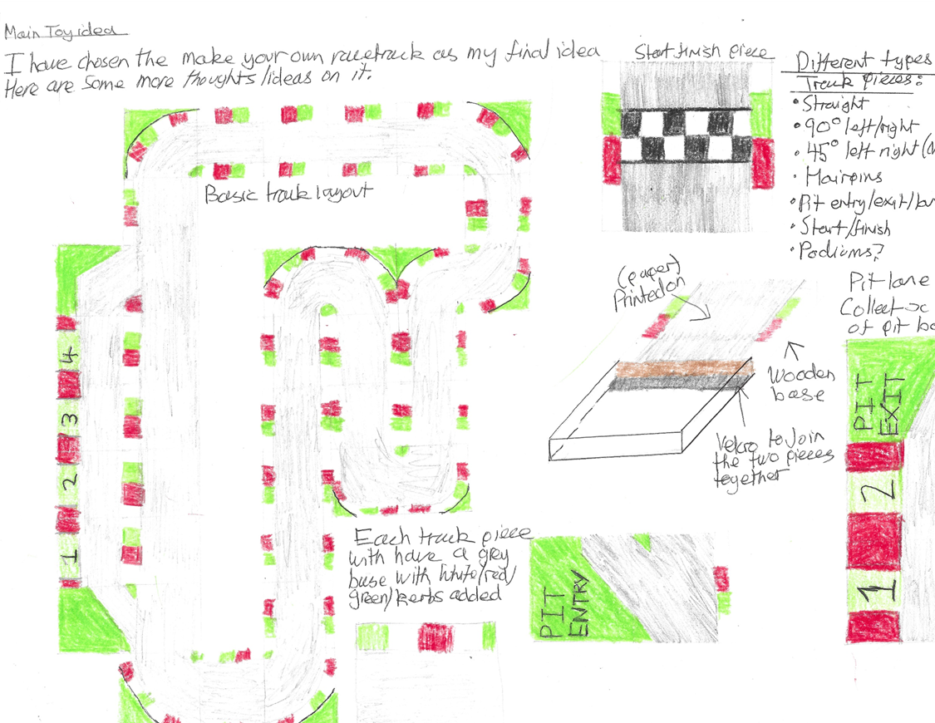
Main Toy ideas
Aim: Start working on chosen idea
Evaluation or next steps: I am happy with my ideas and now I need to start thinking about packaging.

Slide 5
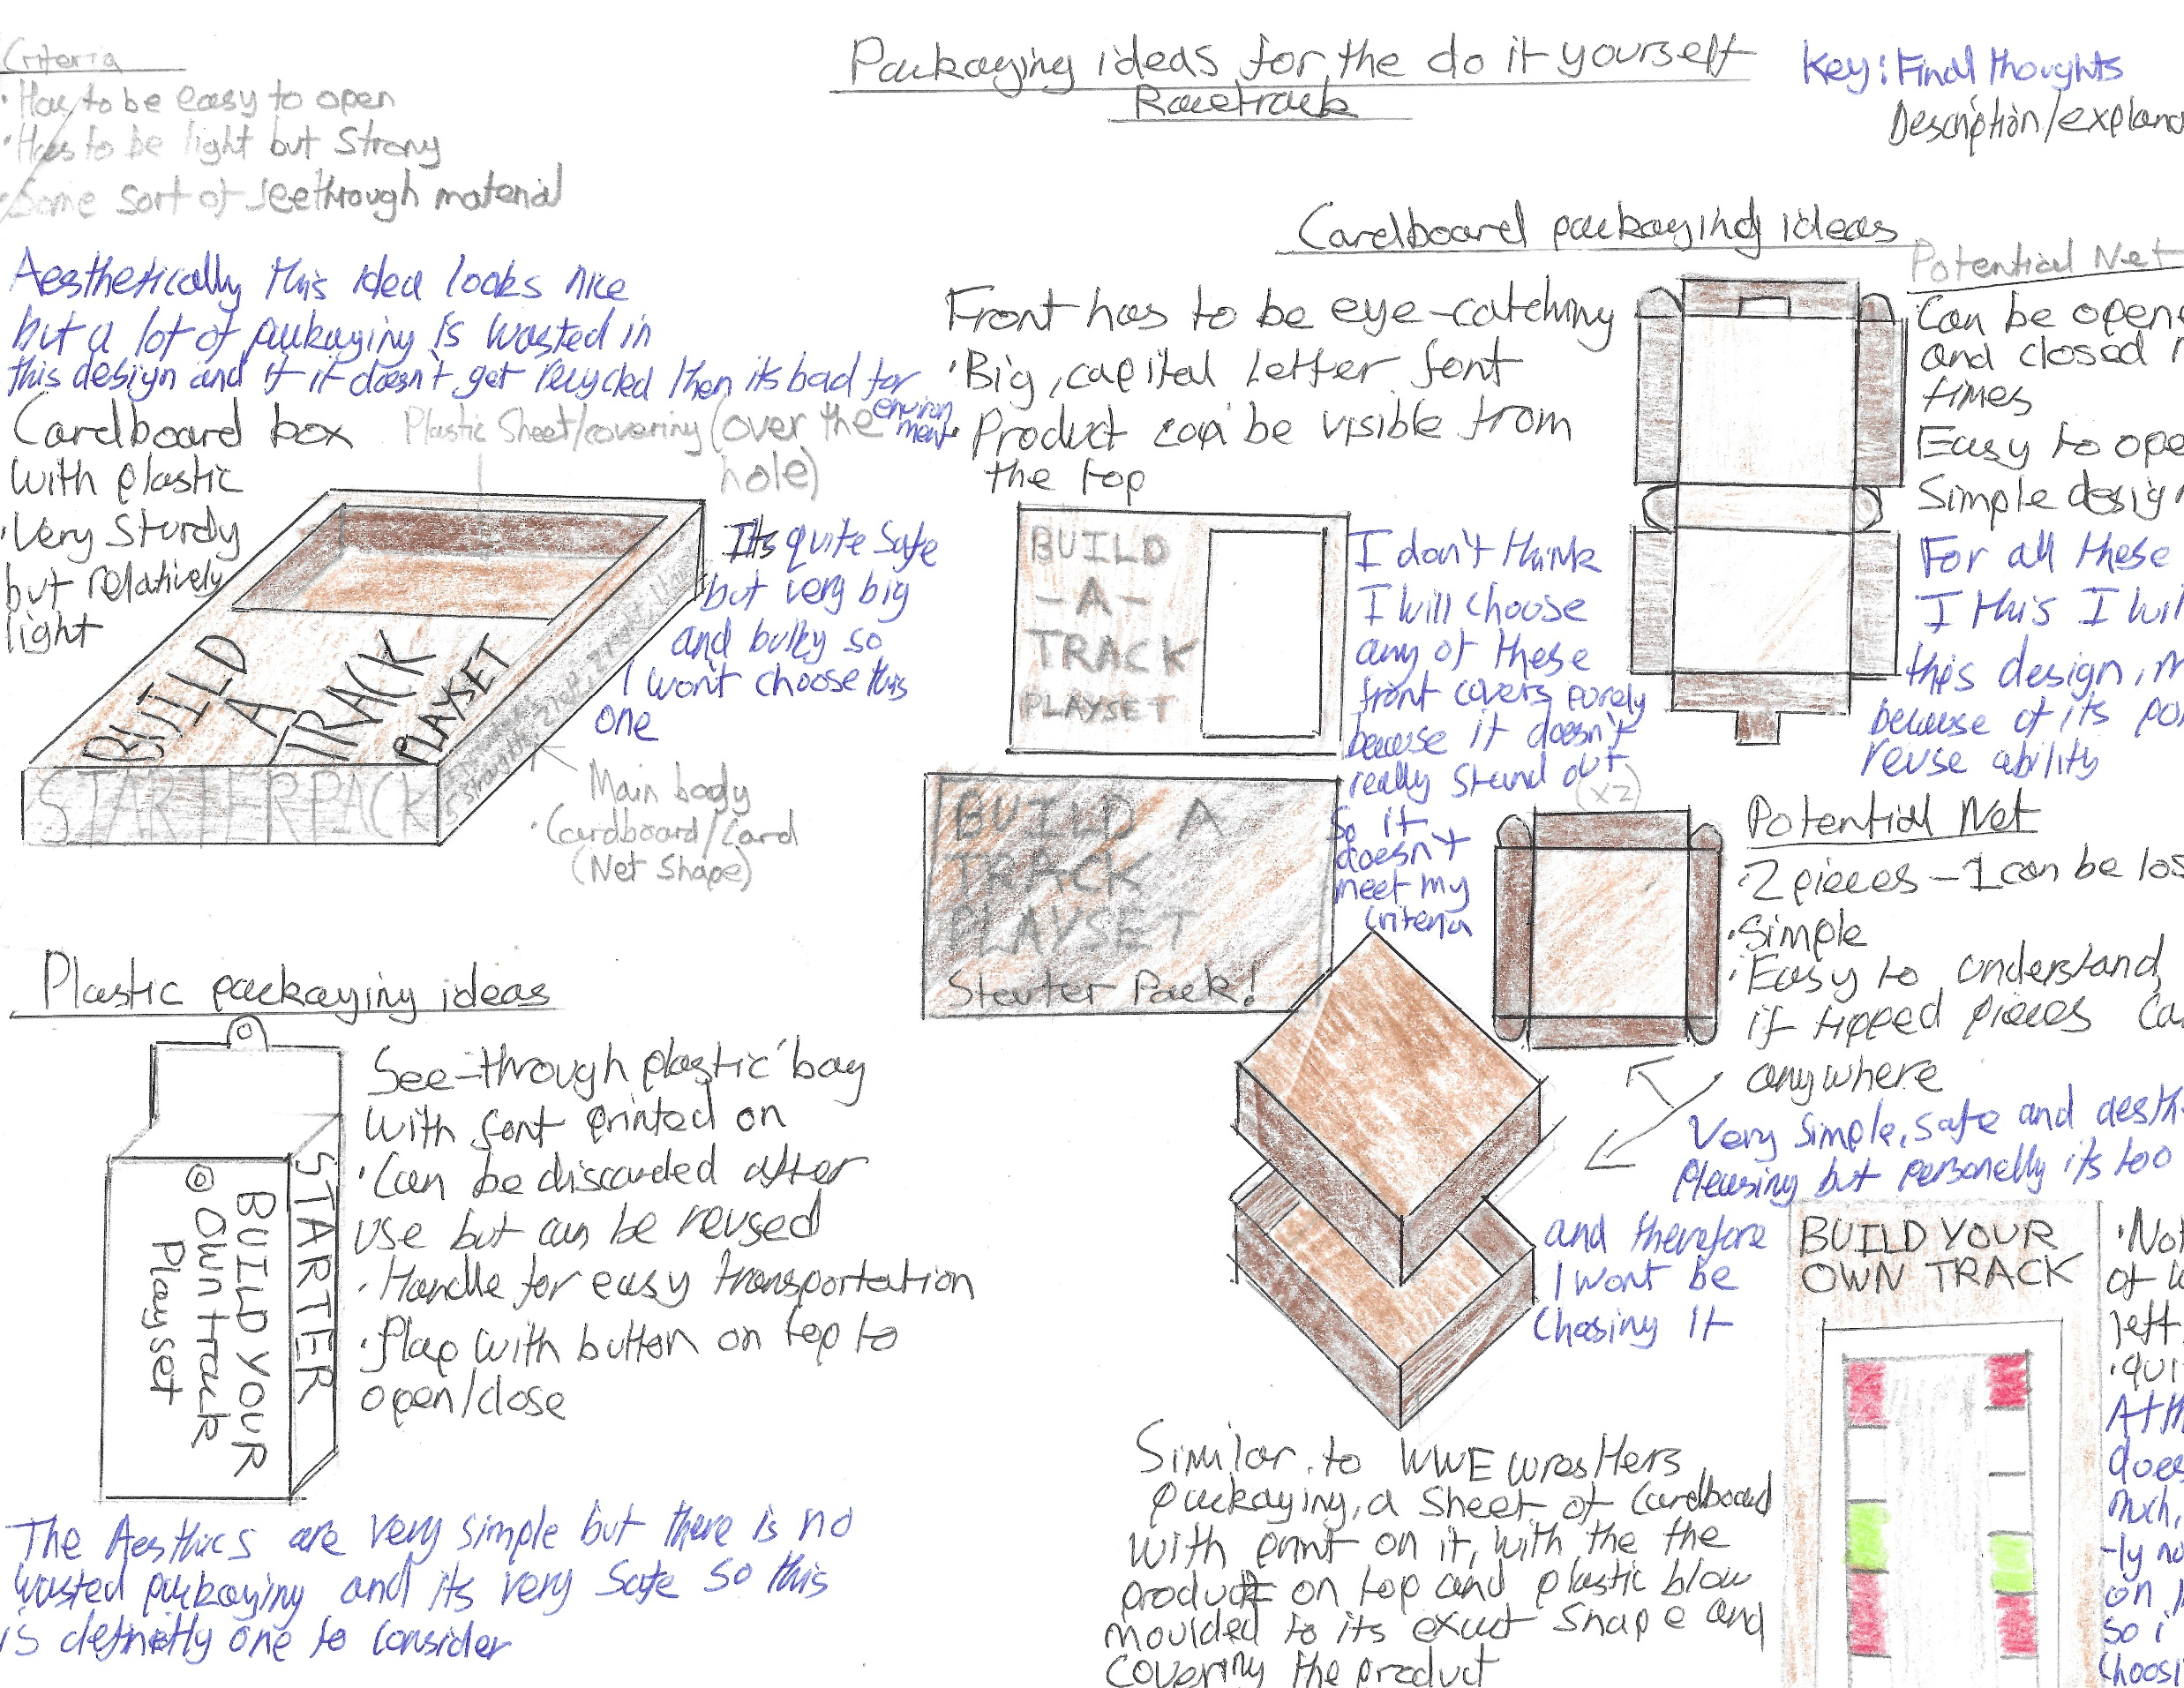
Packaging ideas
Aim: Create packaging for my chosen design
Evaluation or next steps: I have chosen the far upper right hang corner net however I still need to chose the front design.

Slide 6
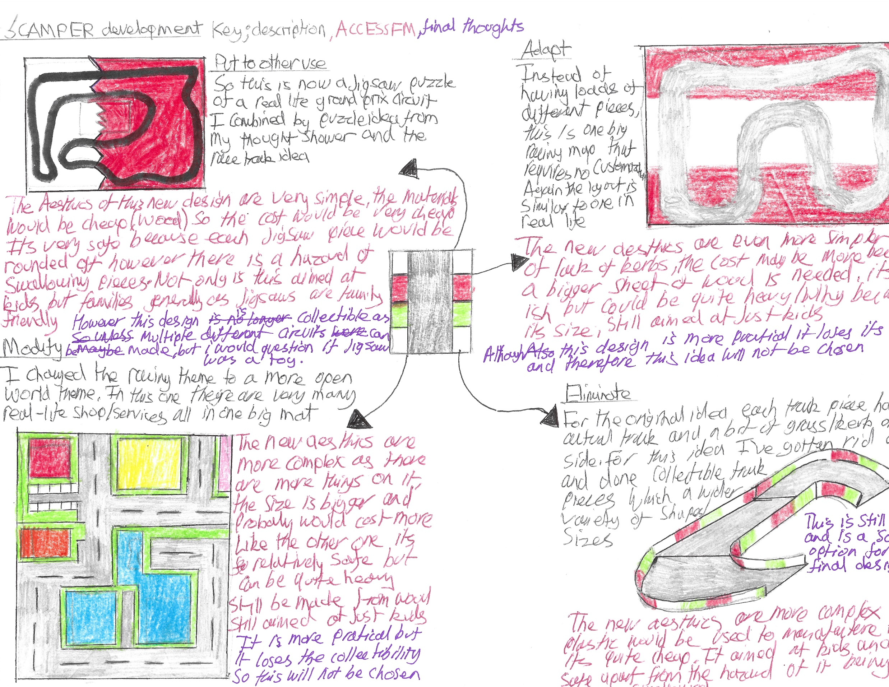
SCAMPER development
Aim: To improve my chosen idea
Evaluation or next steps: Although I like all of these design I will stick wit my original idea as my final design.

Slide 7
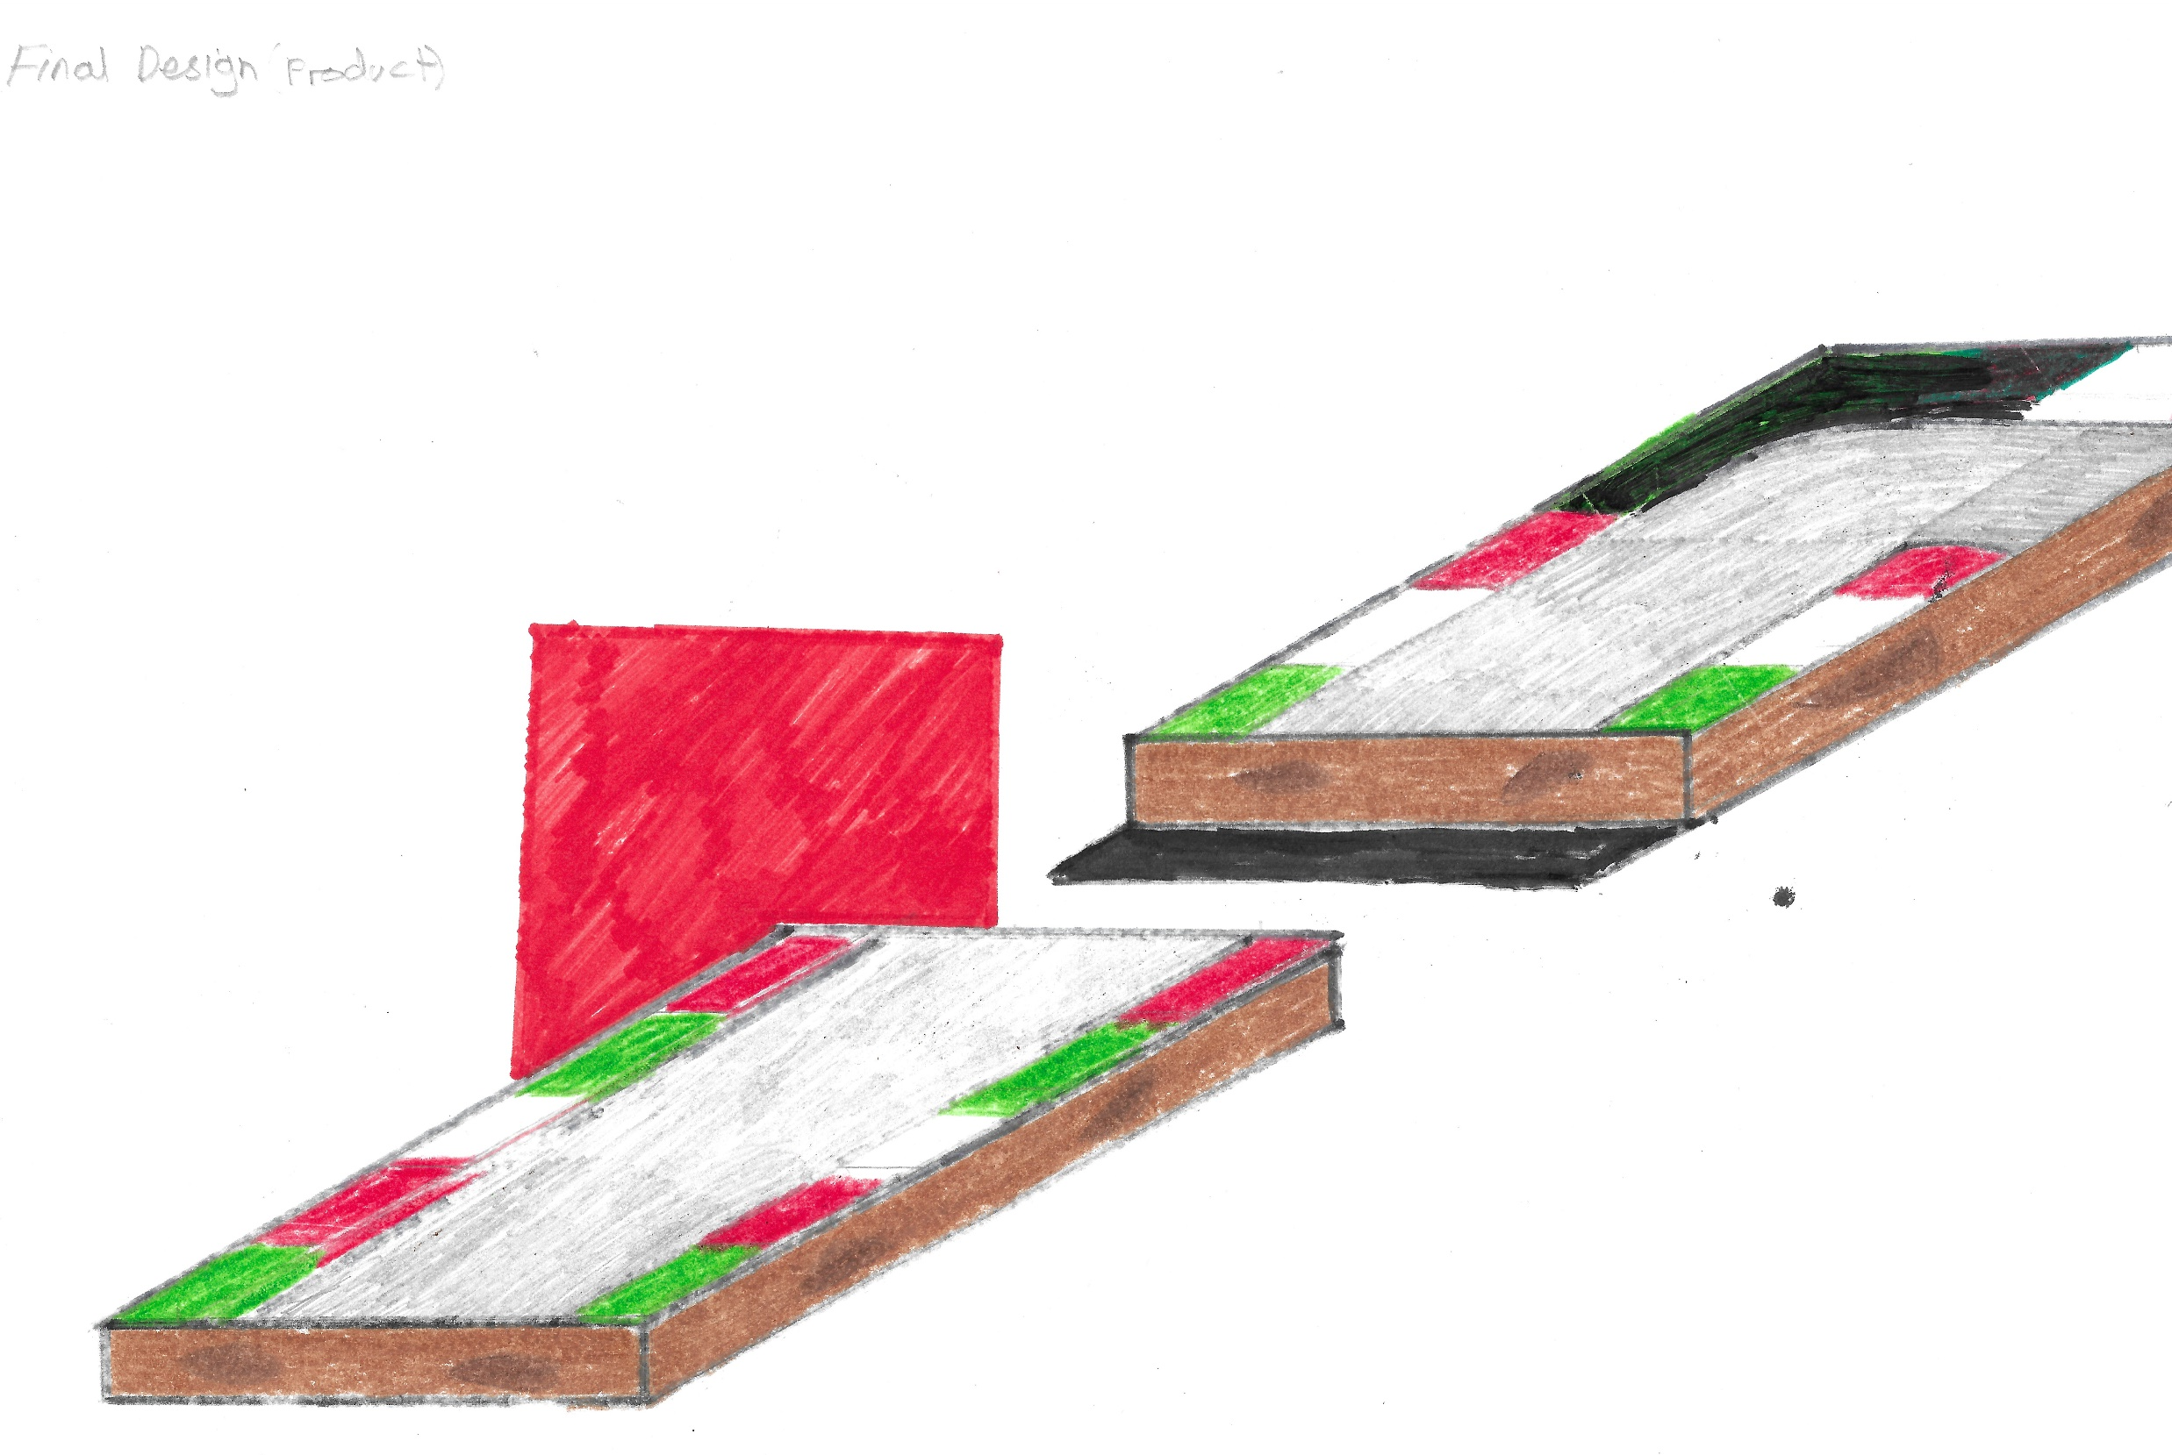
Final design (Toy)
Aim: To show off my final design for the toy
Evaluation or next steps: I am happy with this and will now move on to my final design for packaging

Slide 8
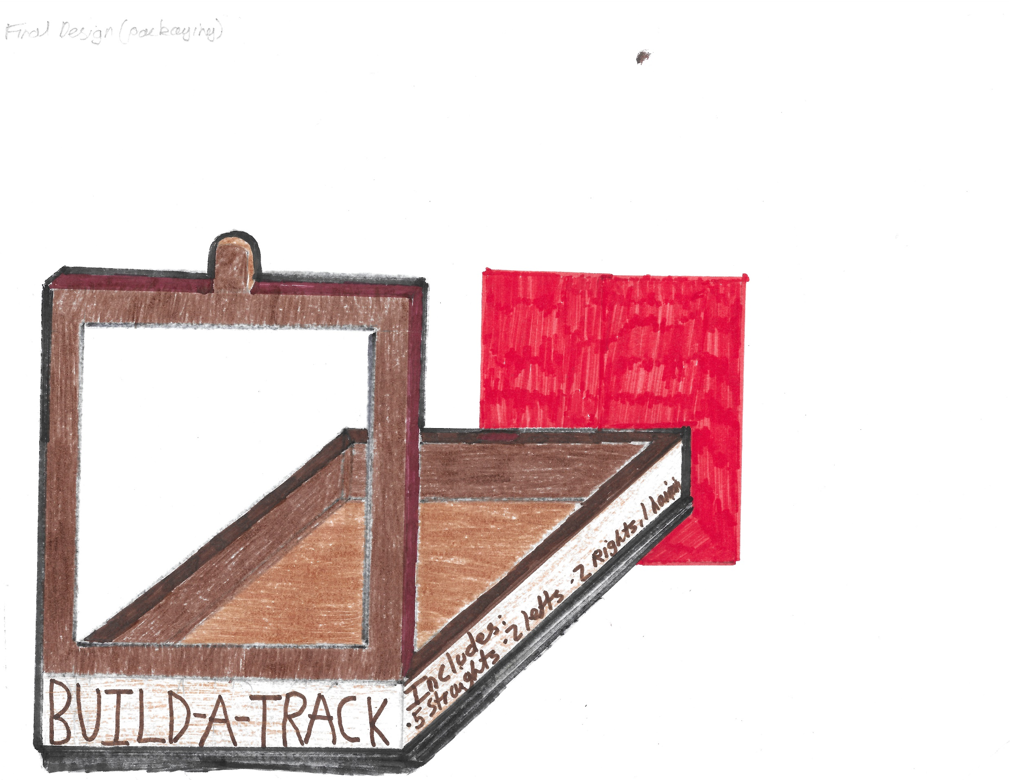
Final design (Packaging)
Aim: To show off my final design for the packaging
Evaluation or next steps: I am also happy with this and will now move on to my models

Slide 9
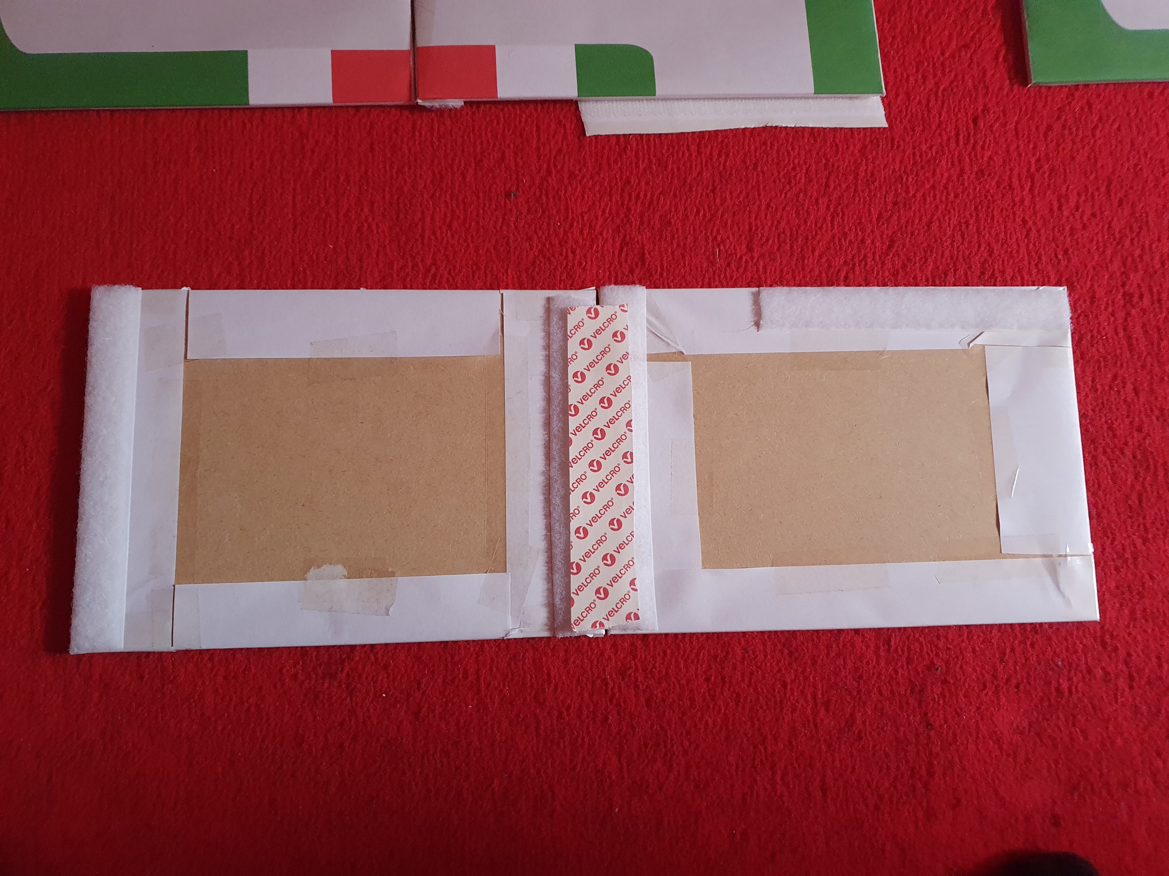
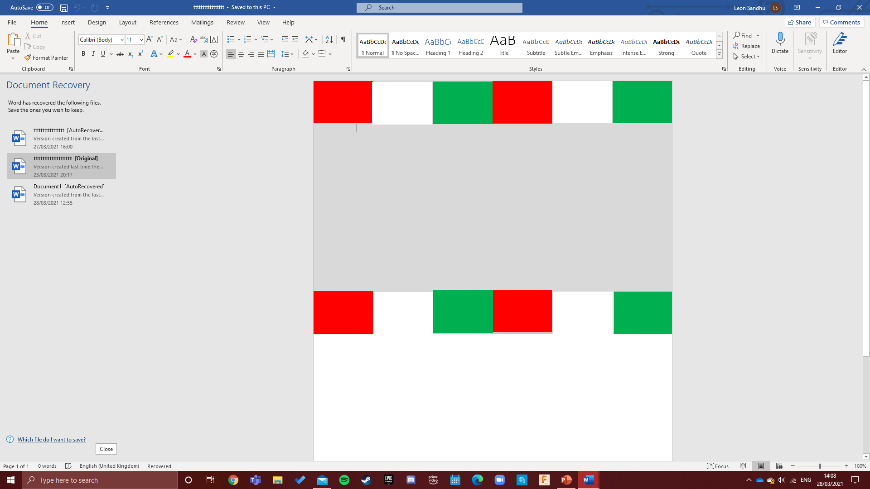
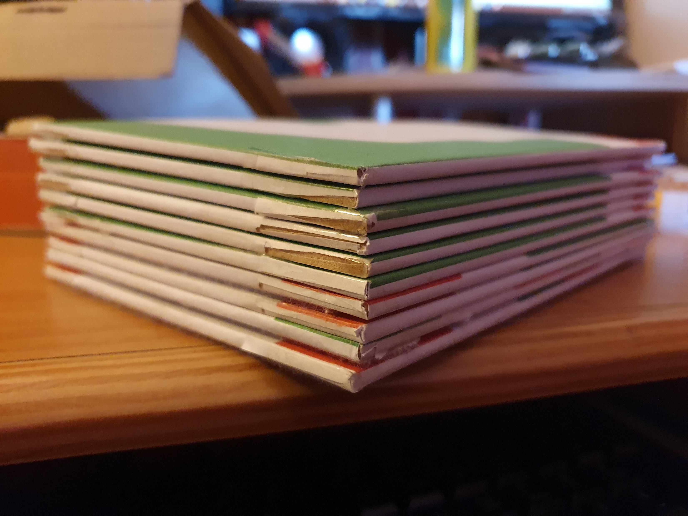
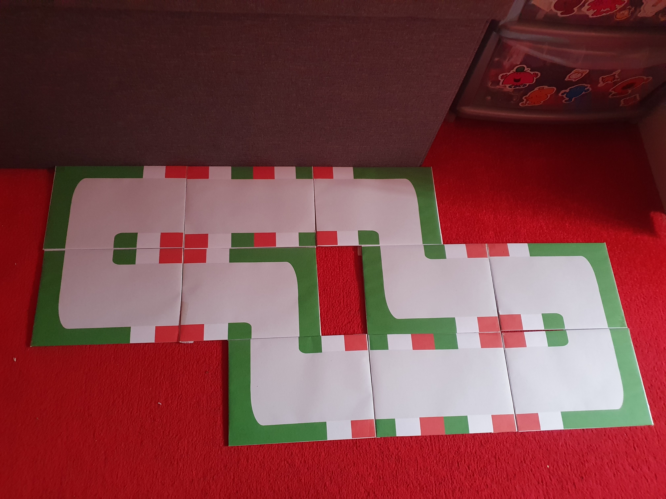
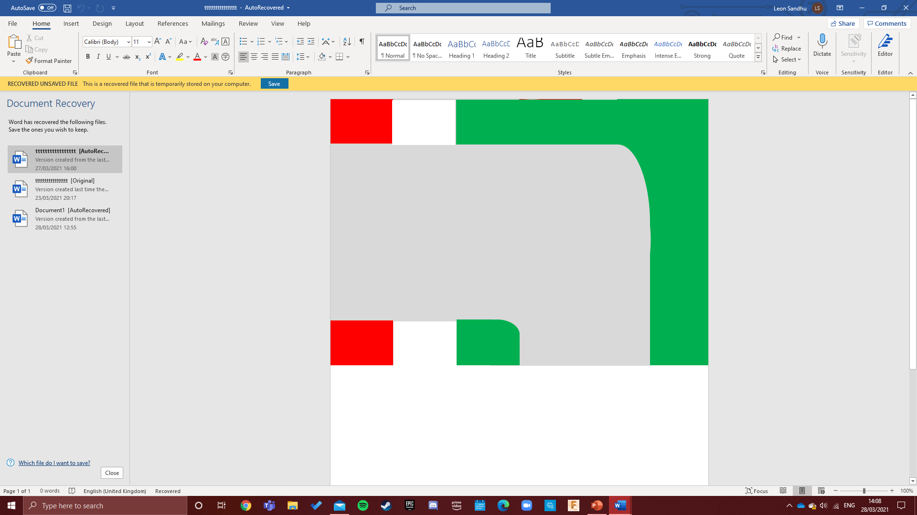
Model (Toy)
Aim: To create a model of my final design.
Materials
For this model I had to use what I had available and what I could access, so the materials I used were MDF ,Velcro ,Paper and Sellotape.
Manufacturing process
The first thing I did was create each straight and corner on Microsoft Word using the “shapes function. I then made sure that the size was a5 because the MDF I had was A5 size. I printed this on A4 paper so I could wrap the paper around the MDF and Sellotape it making it neat and tidy. Once I had made sure each edge was secured for all 10 pieces I added the Velcro to each part where the corner/straight ended. This allowed me to join each part together as one racing track.
Evaluation or next steps: I am exceedingly happy of how my final design turned out and hope to replicate it with my packaging.

Slide 10
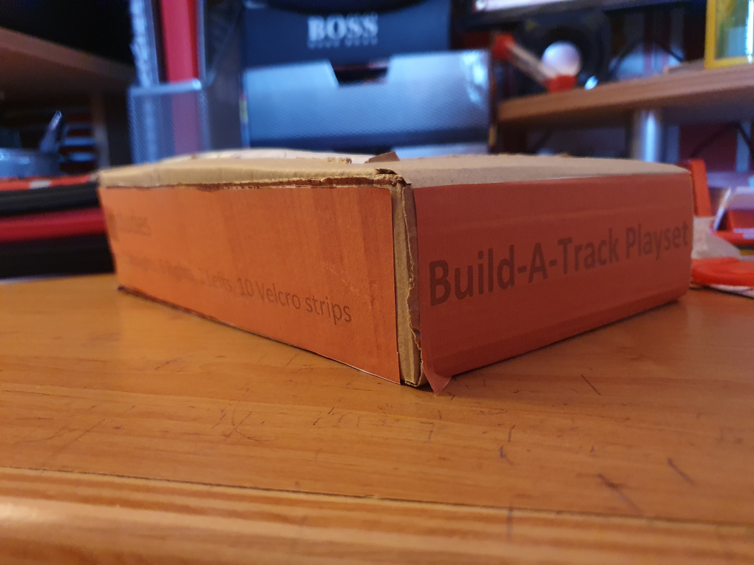
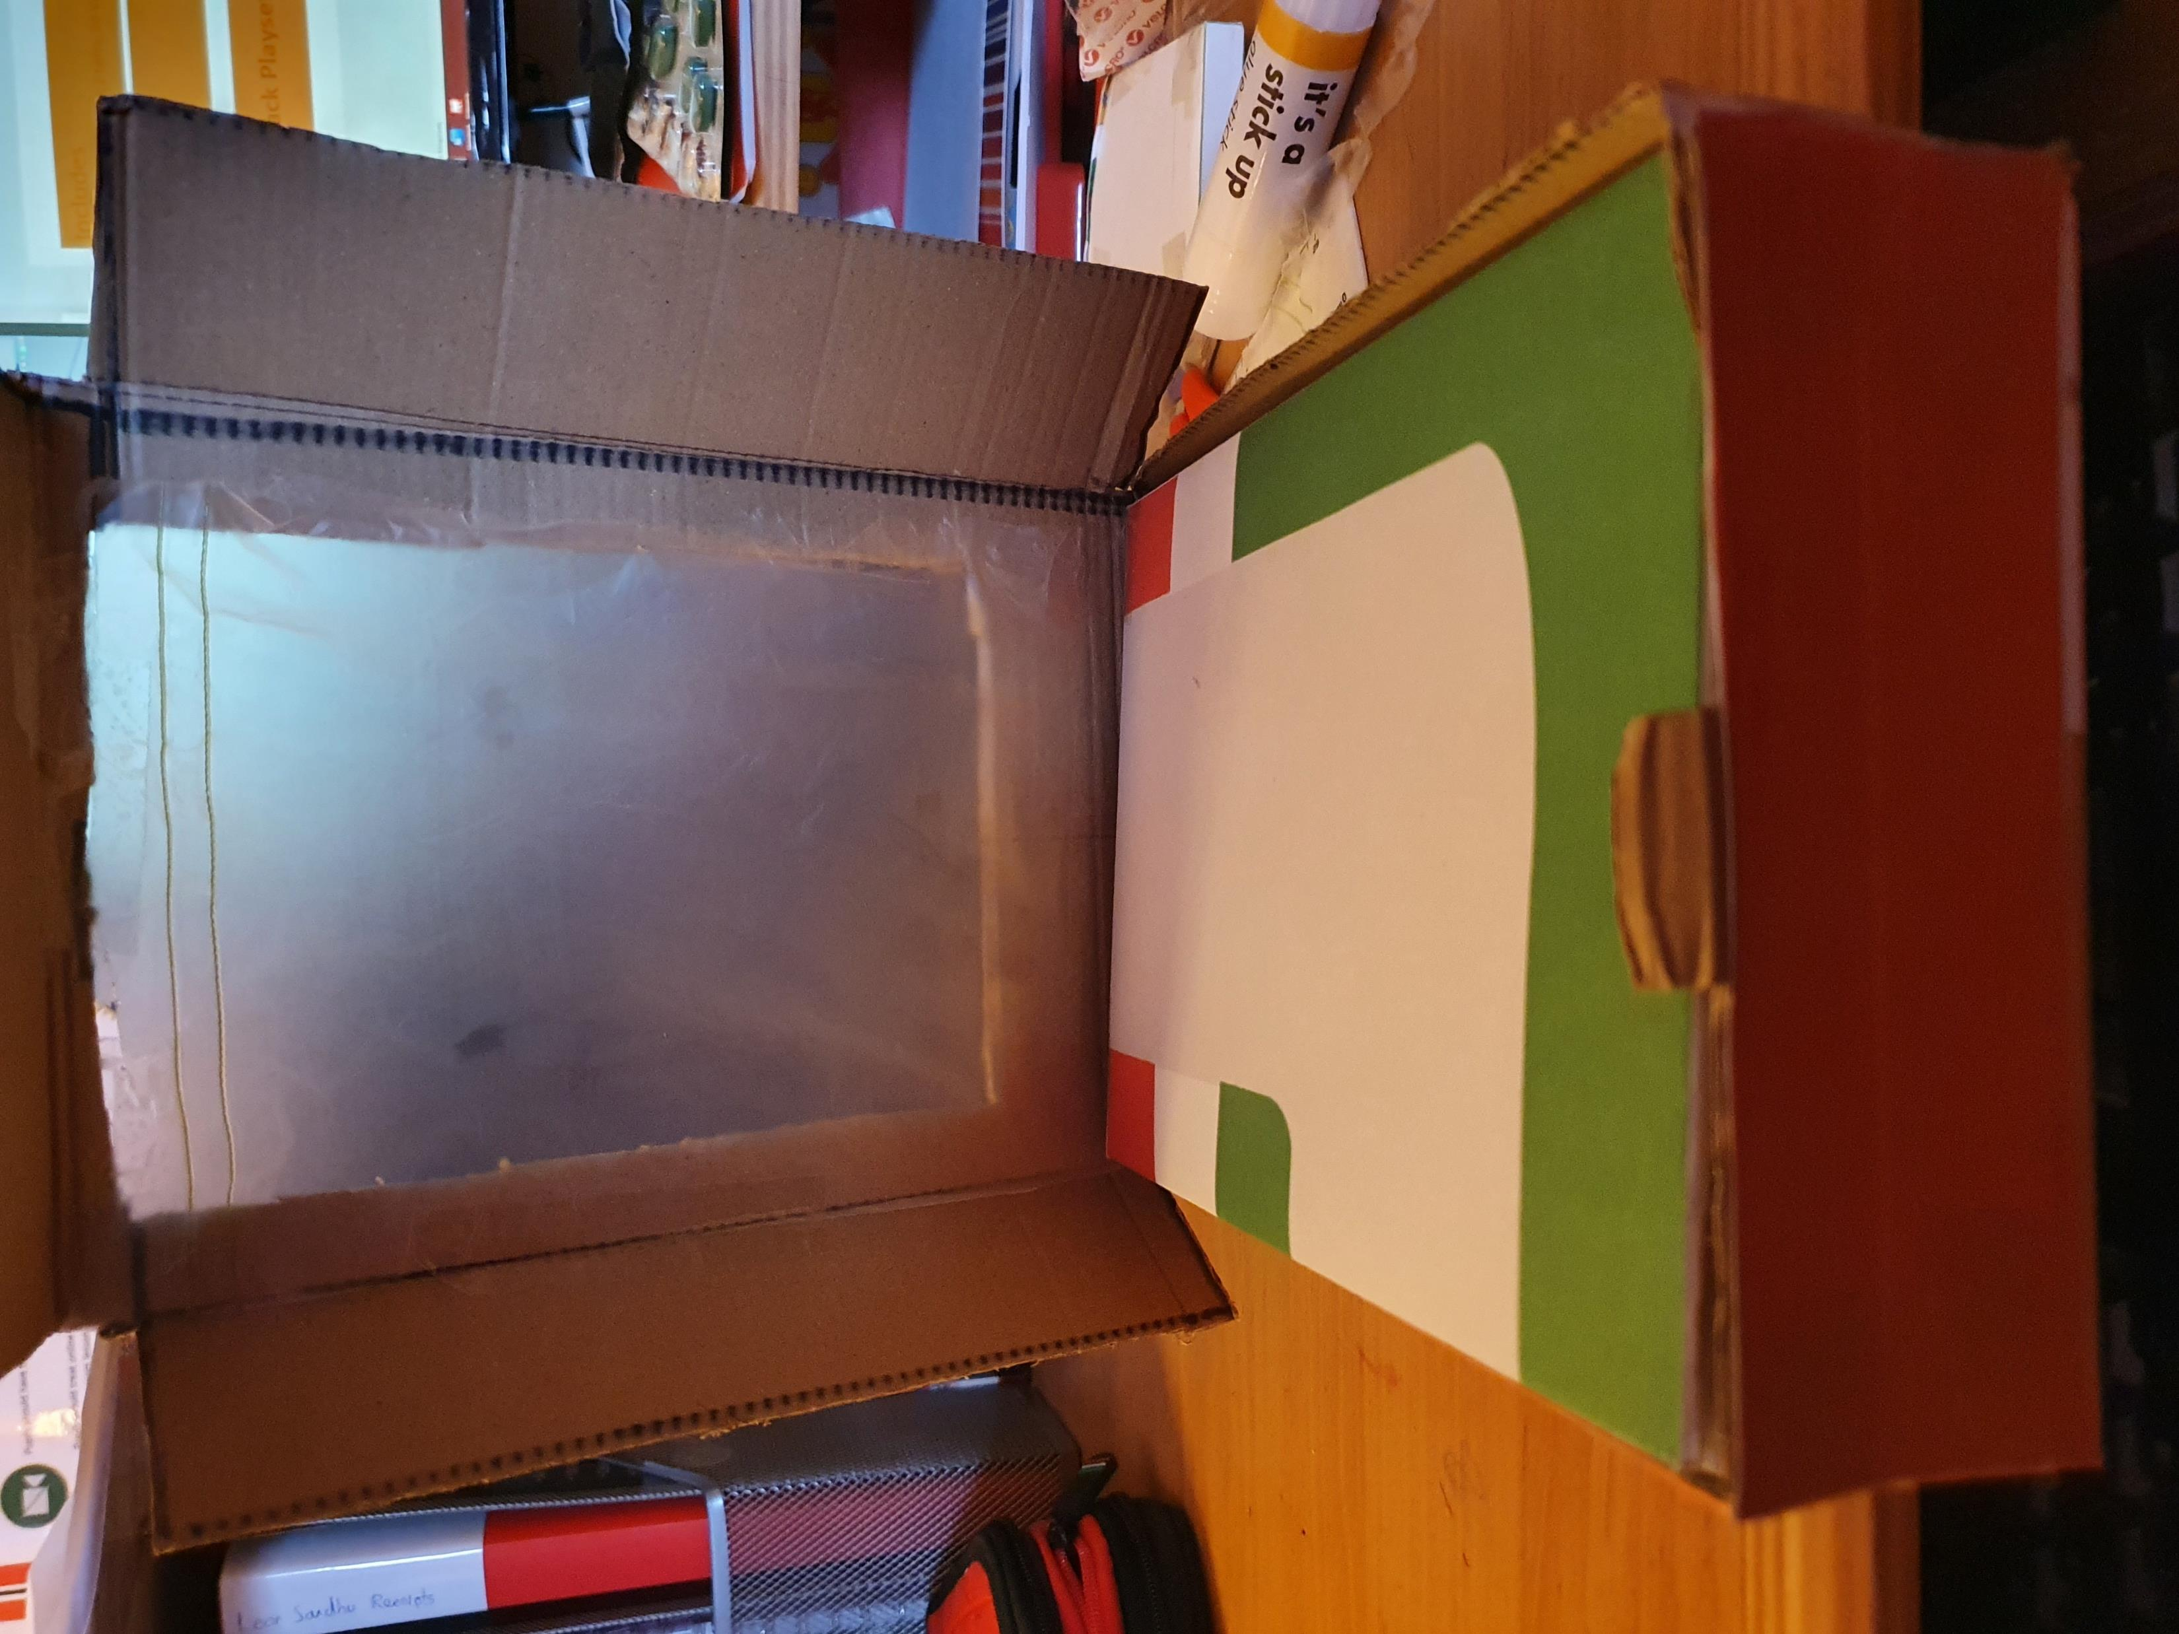
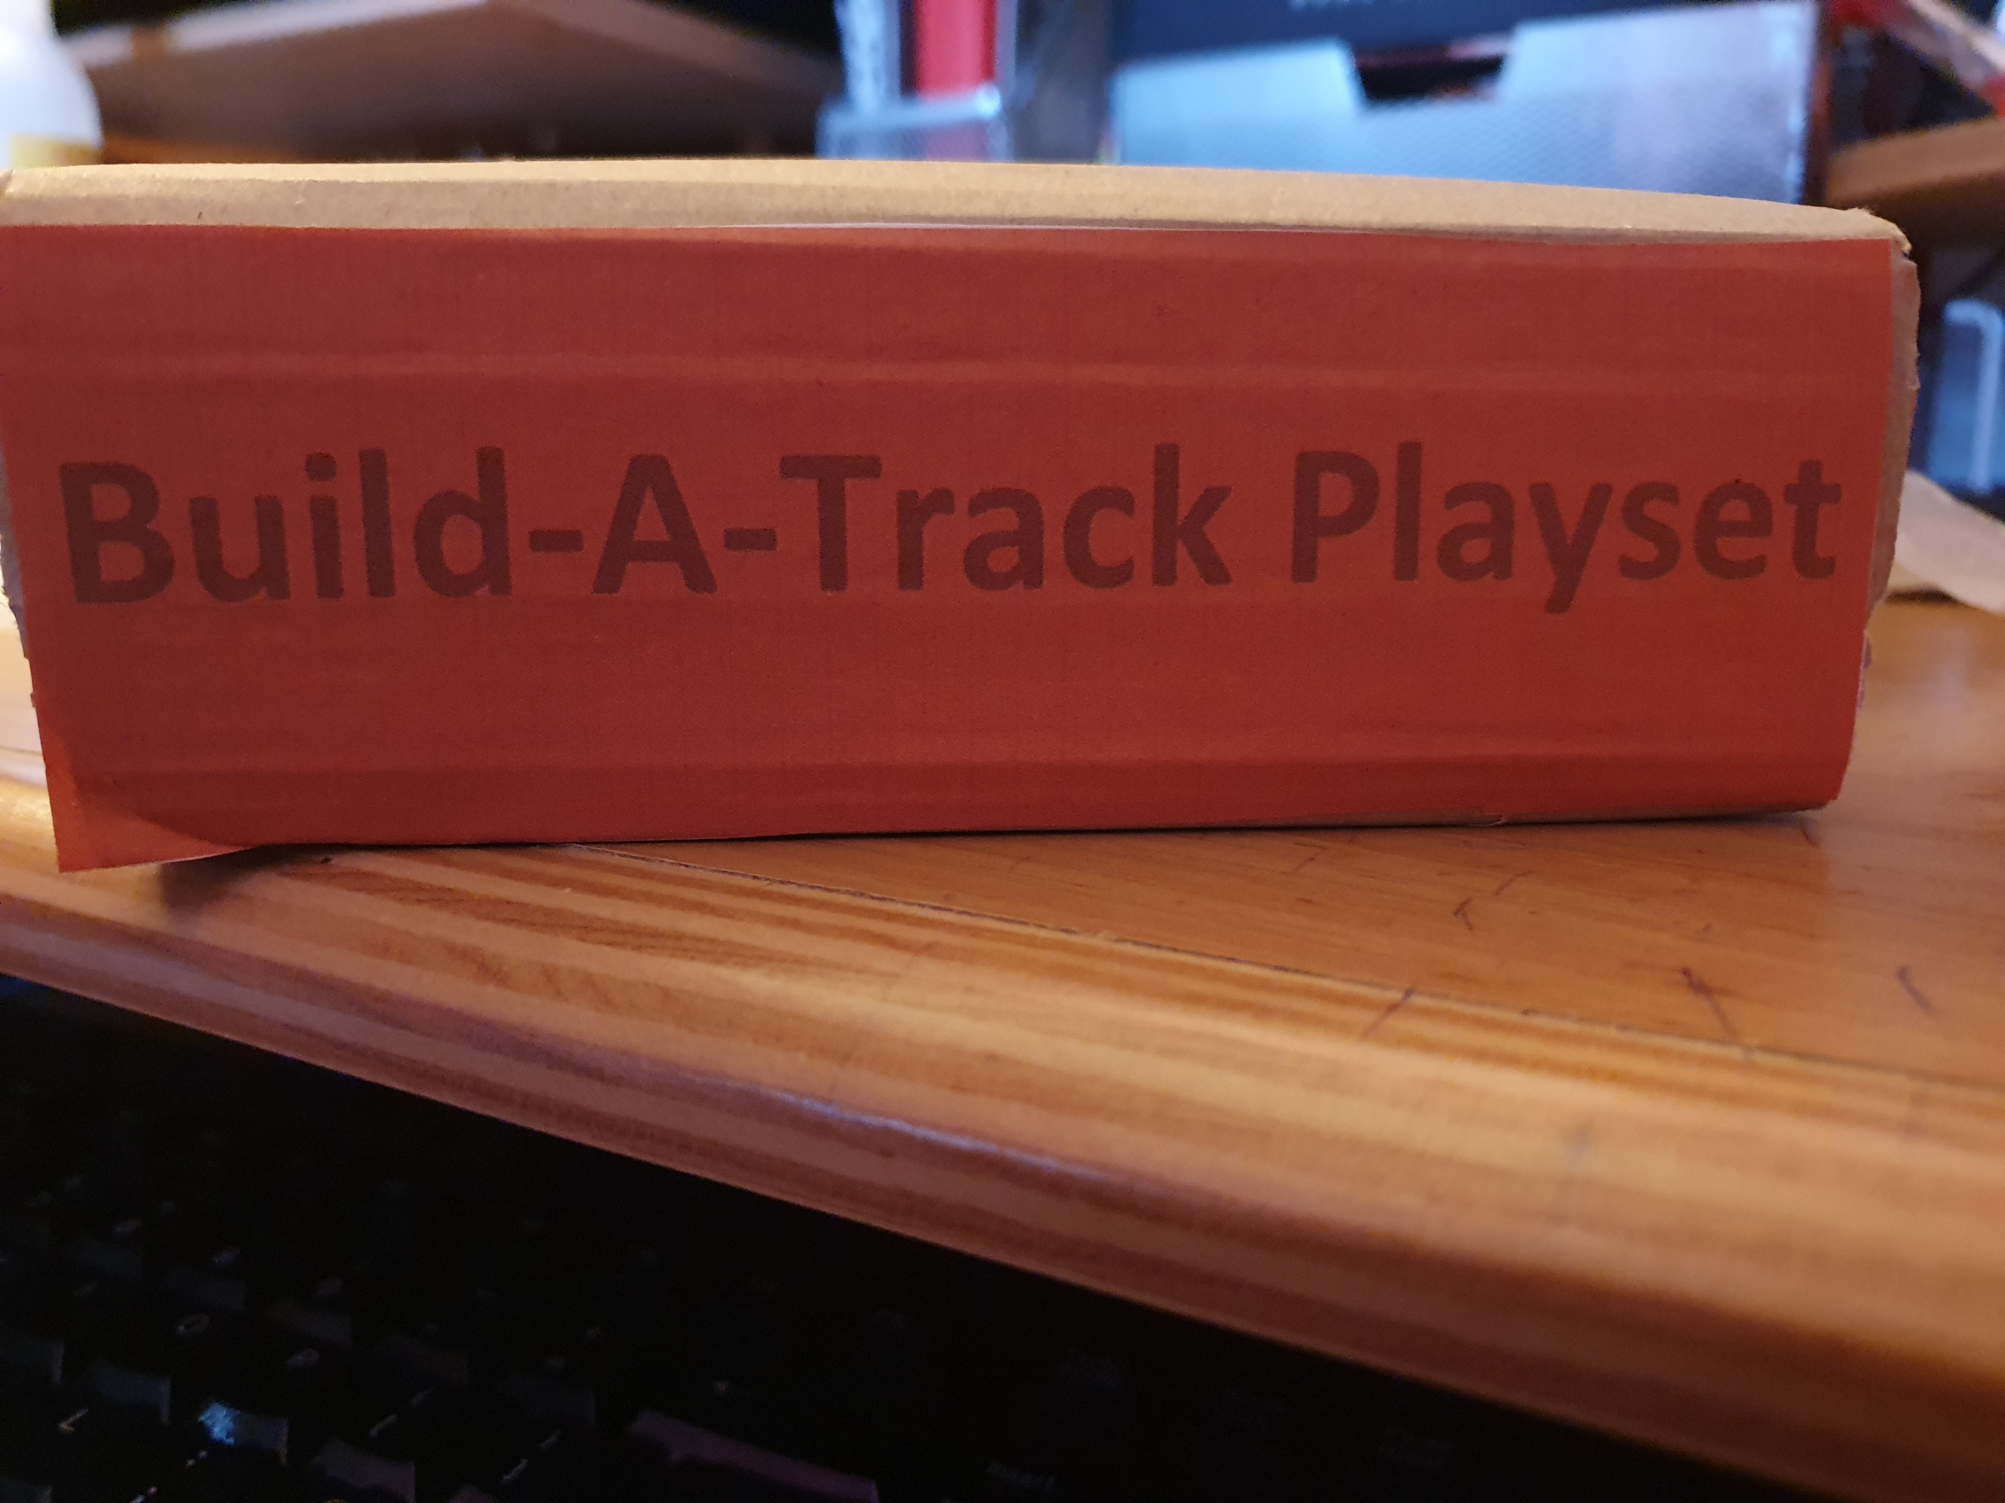
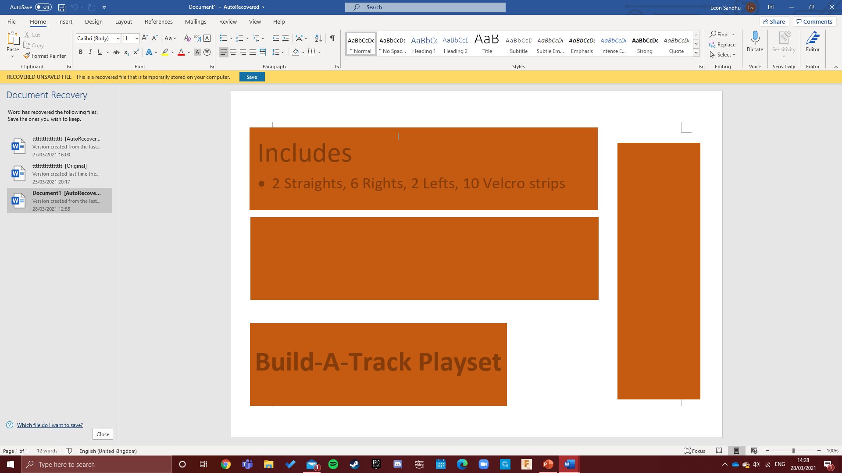
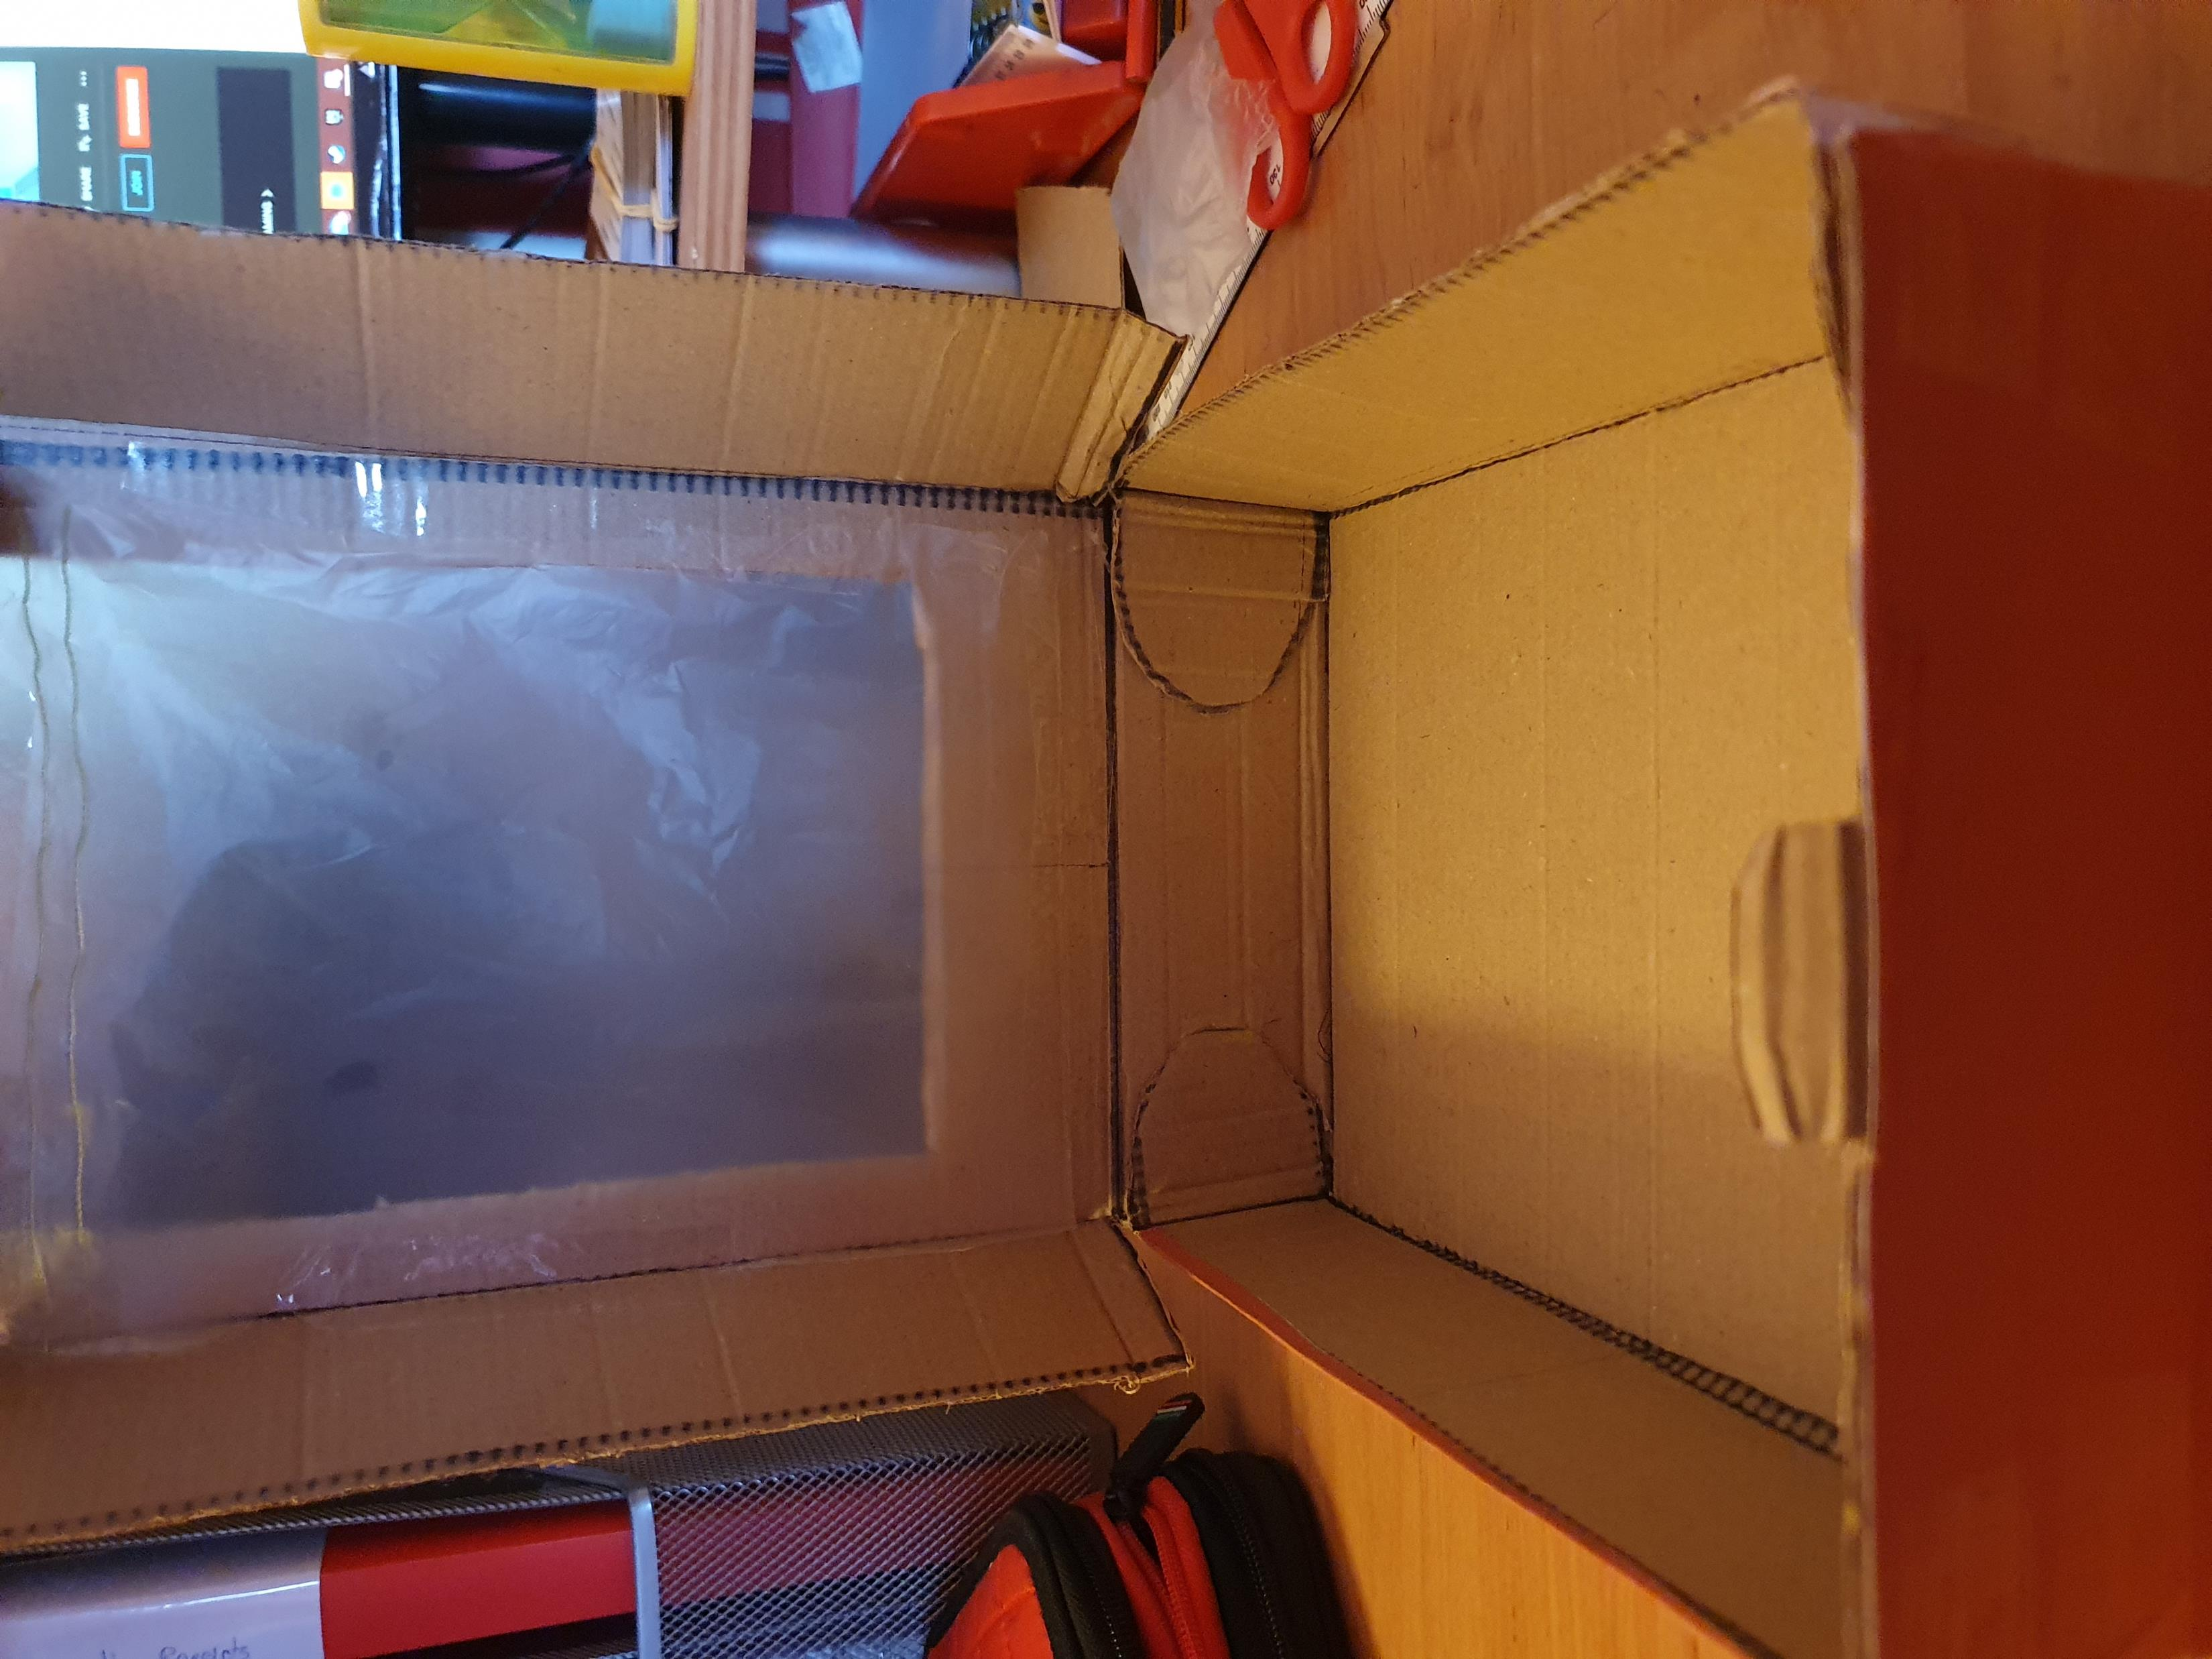
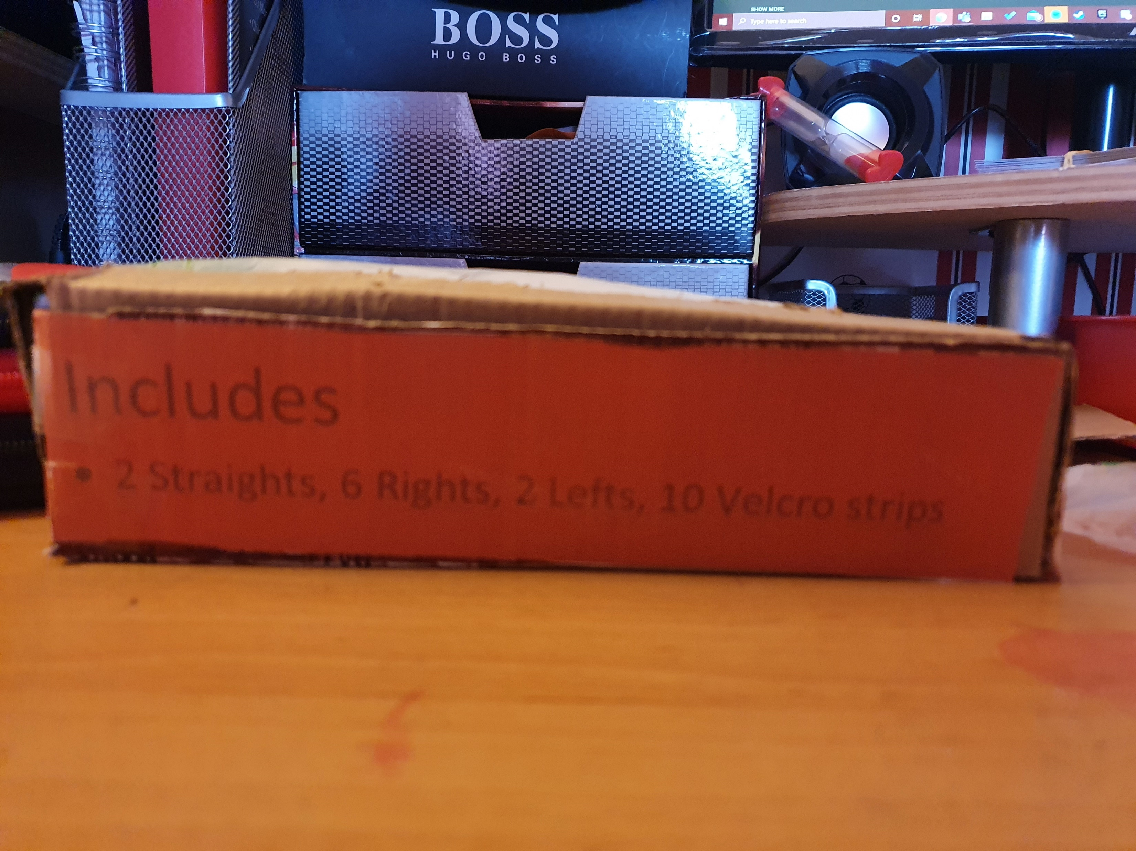
Model (Packaging)
Aim: To create packaging for my final design
Materials
For this design I had easy access to old amazon packaging, so I used the corrugated cardboard, some glue, some sellotape and a sandwich bag
Manufacturing
The first thing I did was rip up some old amazon boxes till I had a flat piece. Then I drew a net of the box, cut it out and started to join it together with sellotape. I then cut a hole on the front, tore open a sandwich bag till I had a flat piece and Sellotaped the plastic bag onto the back of the hole, so the product is visible form outside the packaging. Finally using word, I created the labels using the “shapes” function, printed them off and using glue stuck them on the sides of the box.
Evaluation or next steps: I am slightly less happy than I was with the design purely because of the untidiness that I couldn’t quite ffix on the corners but nevertheless I am still relatively happy with this product.

